Slide 1
Warehouse ManagementSoftware

Slide 2
Introduction
There is a need to create a warehouse management software.
Load articles and products from JSON files.
Store articles with identification numbers, names, and available stock.
Store products with names, prices, and a list of articles with quantities.
Retrieve all products available with their quantities based on the current inventory.
Sell a product, updating the inventory accordingly.

Slide 3
The vision
Designing a system that efficiently manages inventory, products, and transactions within a warehouse environment.
System should address key points
Modularity
Scalability
Data Management
Integration
Real-time Updates
Security
Performance
User Experience
Analytics and Reporting

Slide 4
Stakeholders
Warehouse Managers
Warehouse Staff
Customers
Product Managers
Developers
Business Owners/Executives

Slide 5
Warehouse Managers Concerns
Efficient inventory management
Clear visibility into stock levels
User-friendly interfaces

Slide 6
Warehouse Staff Concers
Ease of use and efficiency
Intuitive interfaces
Clear instructions and error handling

Slide 7
Customers Concern
Product availability and timely order fulfillment
Accurate information on availability and delivery times
Smooth purchasing experiences

Slide 8
Product Managers Concern
Accuracy and completeness of product data
Tools for adding and updating product information
Visibility into product performance and sales data

Slide 9
Developers Concern
Building a robust and maintainable solution
Clear requirements and specifications
Feedback loops and testing procedures

Slide 10
Business Owners/Executives Concern
Overall business performance and profitability
Operational efficiency and cost savings
Scalability and adaptability
Alignment with strategic goals

Slide 11
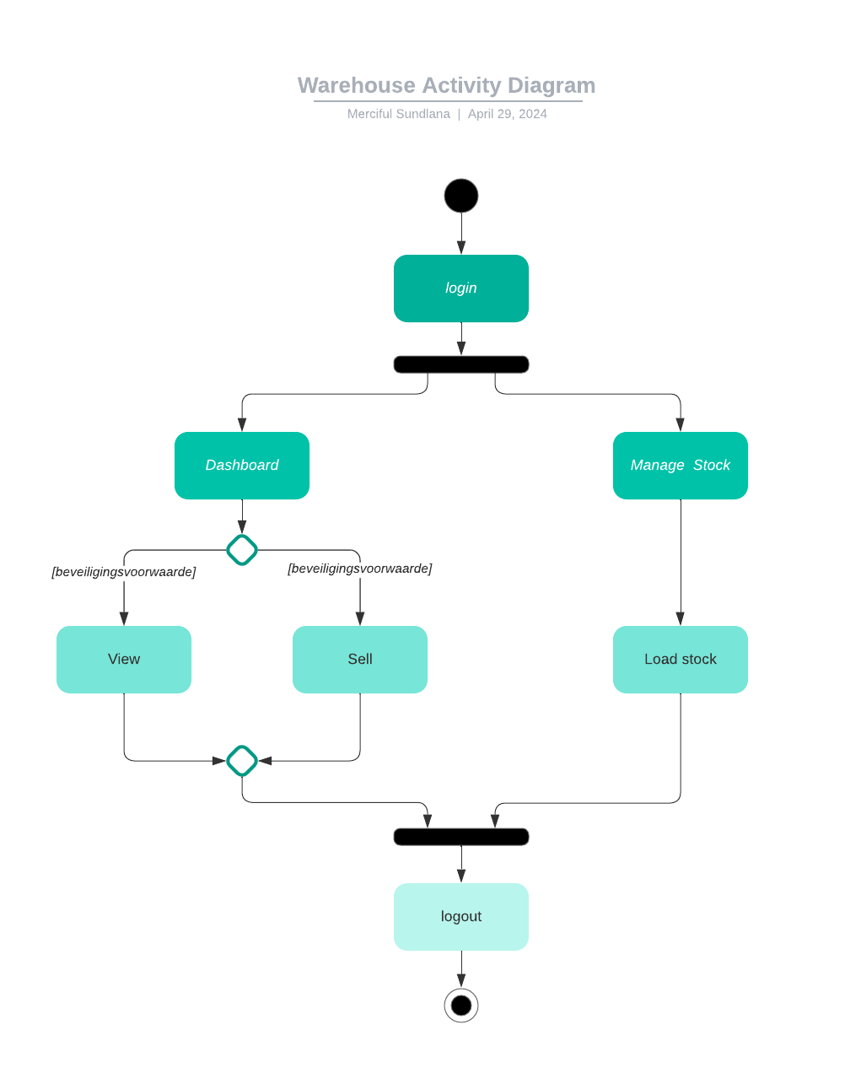
Business Architecture for Warehouse Software

Slide 12
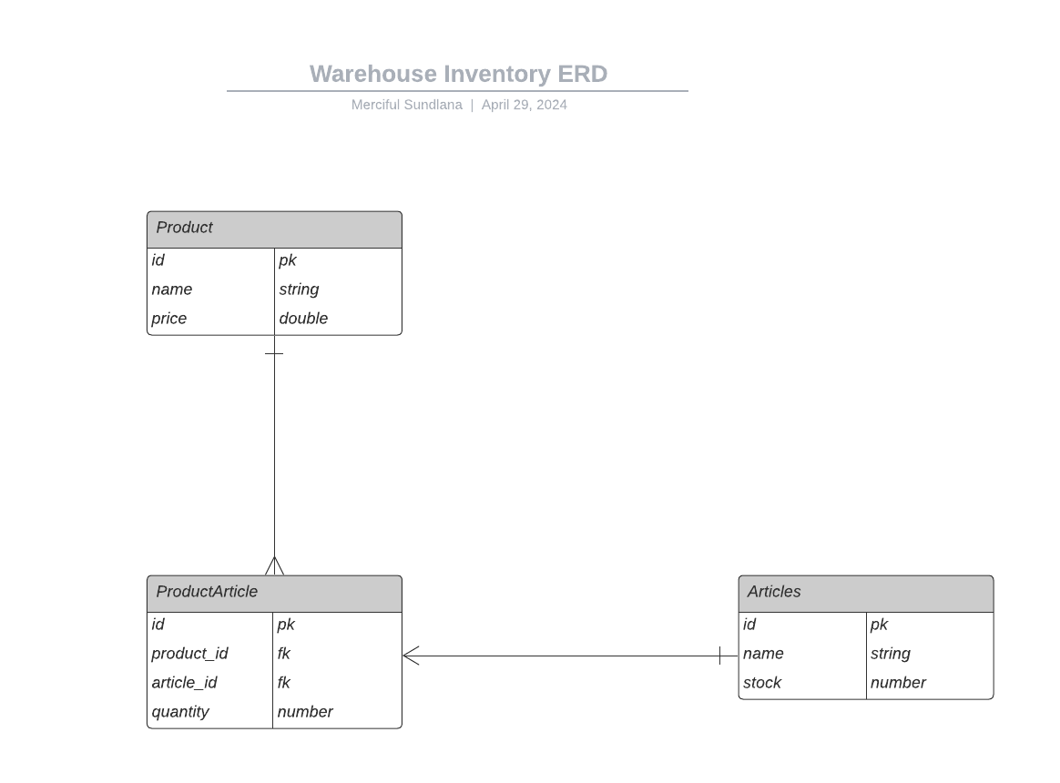
Information Systems Architecture

Slide 13
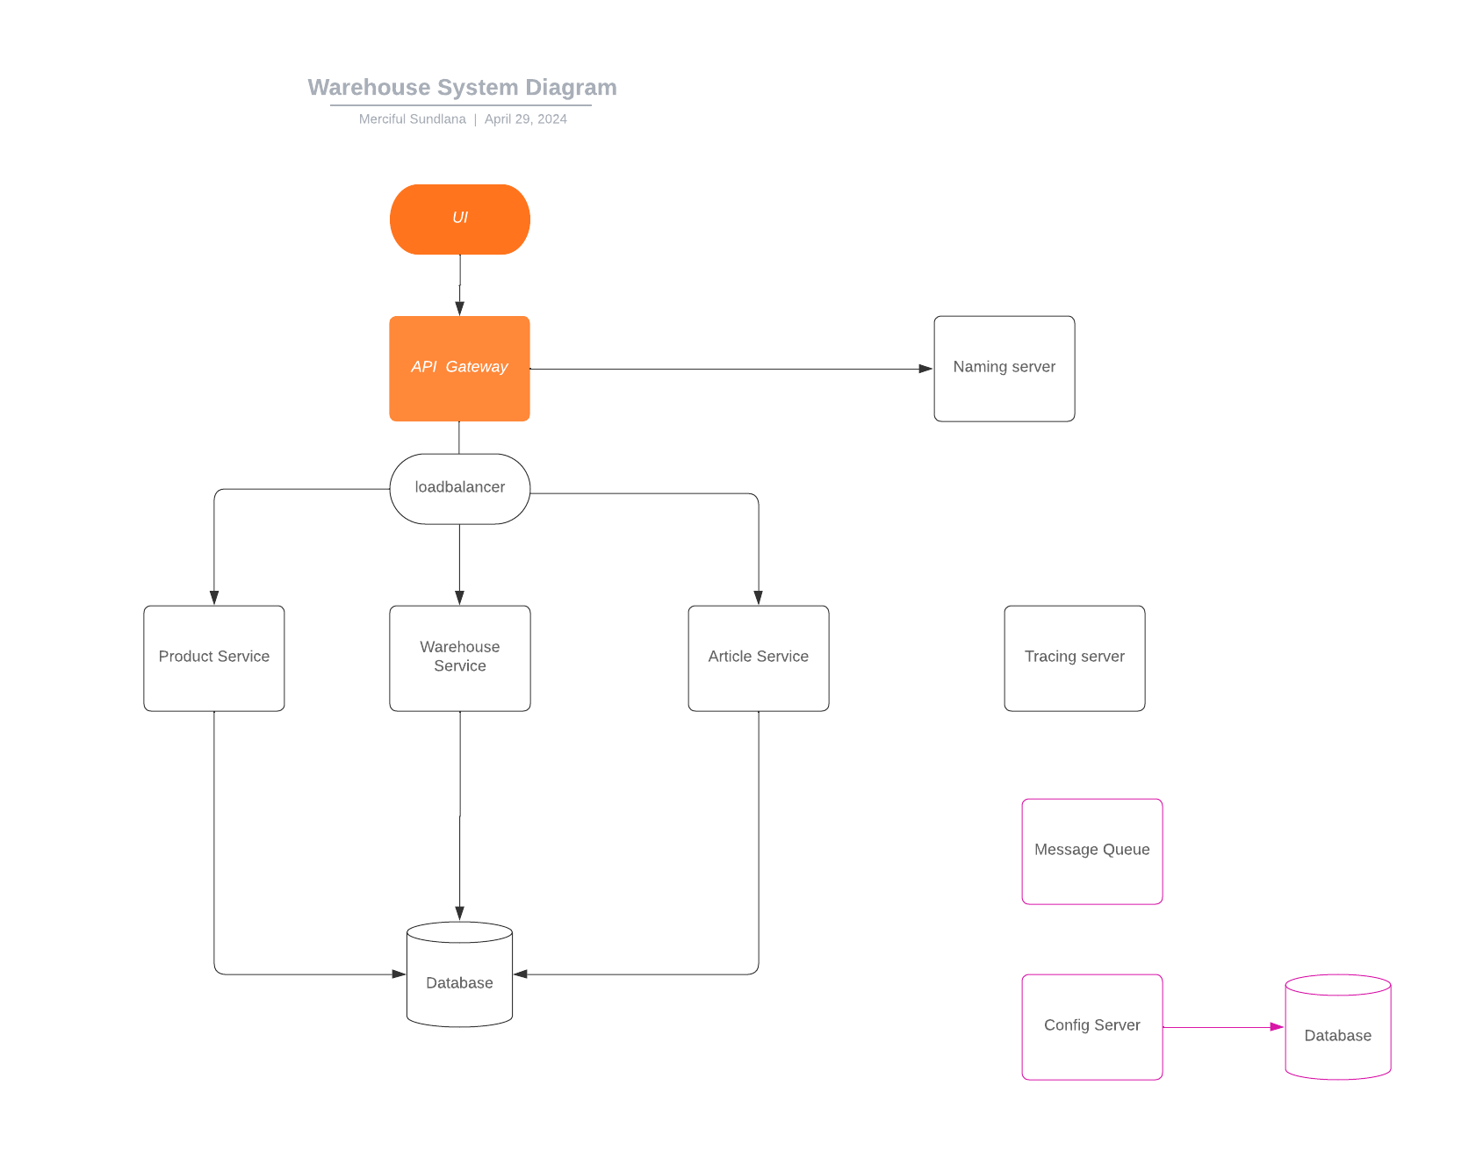
System diagram

Slide 14
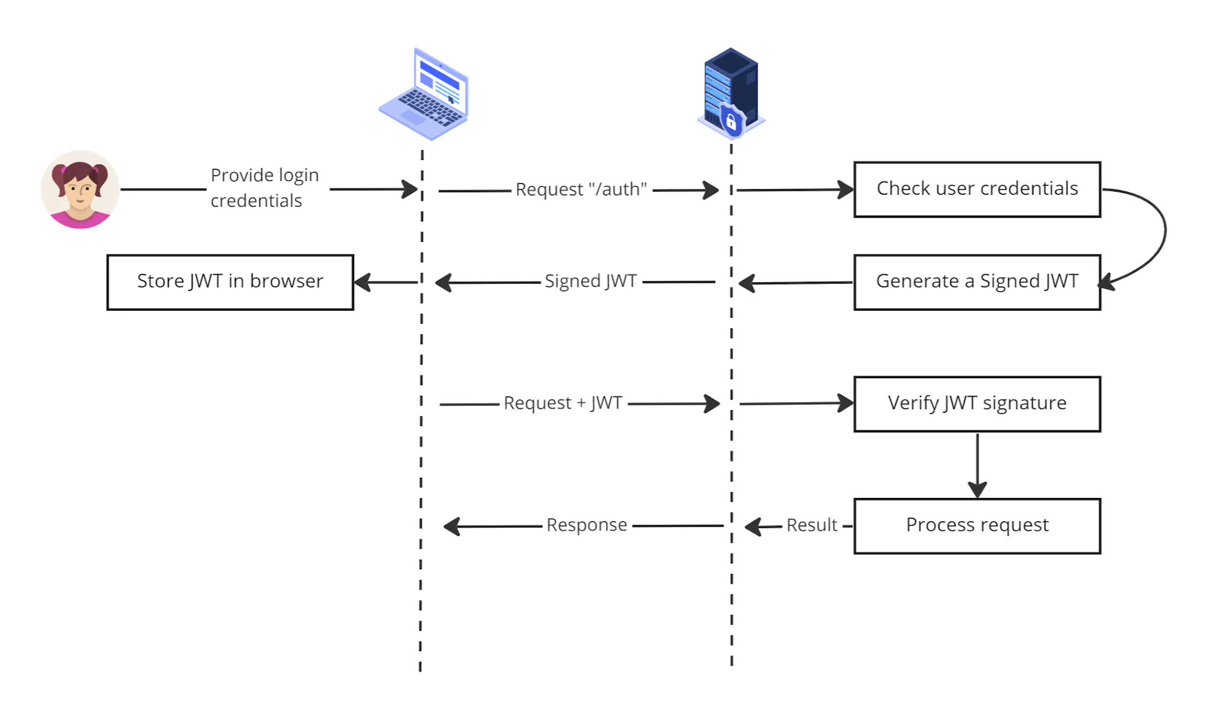
Authentication Process

Slide 15
Technology Architecture
ReactJS User interface
Springboot API
REST
Spring security
Progresql database
Liquibase (data migration)
JWT (access tokens)
Eureka naming server (load balancing and failover of middle-tier services)
Swagger with openAPI
Zipkin tracing server
RabbitMQ (share message between different systems)
Resilience4j (fault tolerance)
Actuator (Can integrate with other JEE frameworks)

Slide 16
Hosting Platform
Office, Email, Teams and or slack communication environments
Figma or Miro collaboration environments
Git repository environment
Docker, Docker Compose and Kubernetes
Cloud environment (Azure, AWS, Google cloud)
Dev, QA and Productions environments (Deployment environments)
CI/CD pipeline tools (Jenkins, Bitbucket or ..)
JIRA or similar (Agile project management tool )
Confluence or similar (Documentation tool)

Slide 17
Documentations
On boarding Document
Requirements Document
Business Architecture Document
Information Systems Architecture Document
Technology Architecture Document
Code Document
Iterations Document
User Document
Release notes Document

